Slide 1

Bright Mart Retail Sales Analysis

Slide 2
Bright Mart Retail Problem Statement
Bright Mart is experiencing uneven performance across products, regions, and customer groups. While categories such as Clothing and Beauty and regions like the Eastern Cape show strong revenue and high demand, other area particularly Home Appliances, Electronics, and certain age groups are underperforming. Additionally, procurement costs represent a significant 65% of total sales, reducing the potential for higher profit margins.

Slide 3
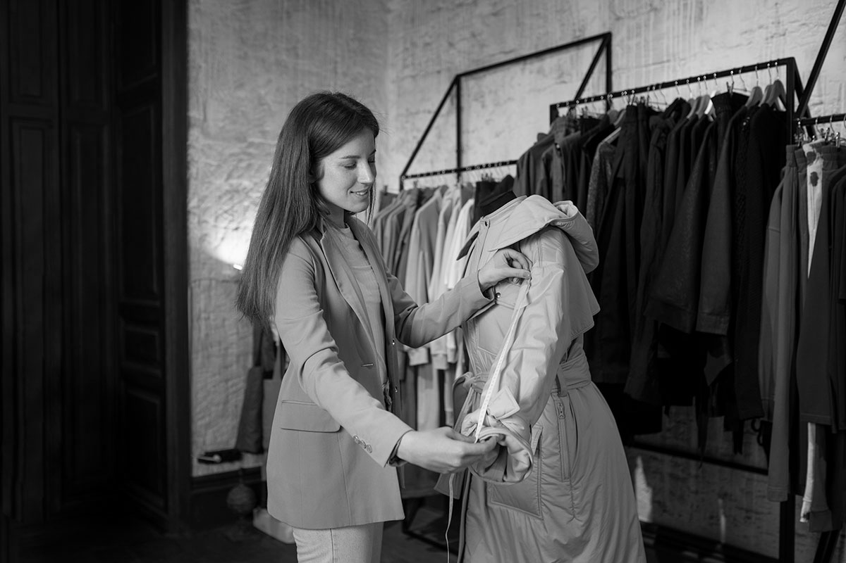
01.
Sales Analysis

Slide 4
44M
14.92M
28.59 M
Total Sales
Total Profit
Total Cost
Bright Mart Retail generated R44M in total sales, with R28.59M in costs and R14.92M in profit
across all provinces in the 2024 financial year.
This resulted to a 34% profit margin which indicates growth, great performance and profitability.
Total Cost is 65% of total sales this reveals that procurement is the biggest expense
Recommendations
Reduce costs by 10% by sourcing alternative suppliers with competitive pricing
Adjust pricing for in demand products slightly without reducing sales.

Slide 5

02
Product Analysis

Slide 6
Perfume
Jacket
Dress
Shampoo
T-shirt
1 ,14M
1,24M
1,26M
1.19M
1,27M
The top performing products are Dress,Perfume,Jacket,Shampoo and T-shirt
This clearly shows that the Clothing and Beauty categories are the strongest performers, indicating high customer demand.
Meanwhile Home Appliances and Electronics are preforming poorly regarding revenue
Recommendations
Create targeted promotions for clothing and beauty products.
Use social media campaigns focused on fashion and self-care.
Improve marketing visibility for home appliances and electronics
Advertise bundle offers to encourage sales in the electronics and home appliances category

Slide 7
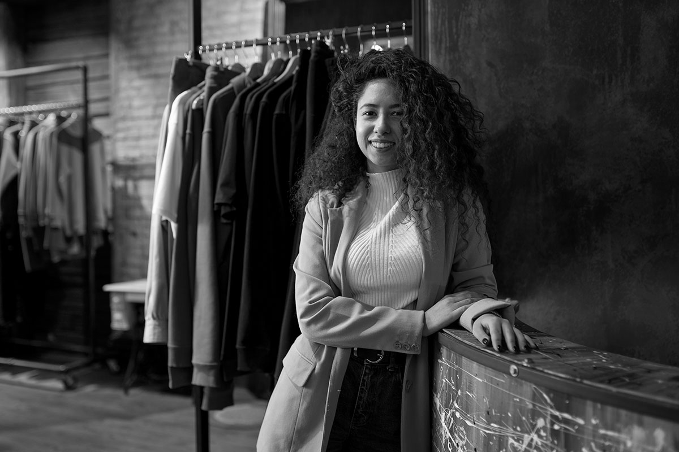
Customer Analysis
The customer is KING

Slide 8
4,2M
4,7M
18-25
26-35
36-45
46-60
4,3M
3,7M
The 36–45 age group generated the highest sales at R4.7M ,this group is more stable in terms of finances
This indicates that they are the target customer for clothes ,beauty electronics as well as appliances.
18–25 although not financially stable they follow trends which is the driving force for sales in this age group.
46-60 contributed R3.7M, the lowest of all groups, this group is less interest in fast-fashion or beauty trends
Recommendations
Create Trend-based marketing
Promote senior-friendly bundles
Offer loyalty rewards as the returning customers makes up 87% of sales
Invest in marketing for provinces that are performing poorly

Slide 9
Top performing Provinces
Eastern Cape
Kwazulu Natal
Free State
6,9M
6,4M
6,3M

